Slide 1
GCBASIC
PIC18FxxQ24
Part 17 - Using CLC

Slide 2
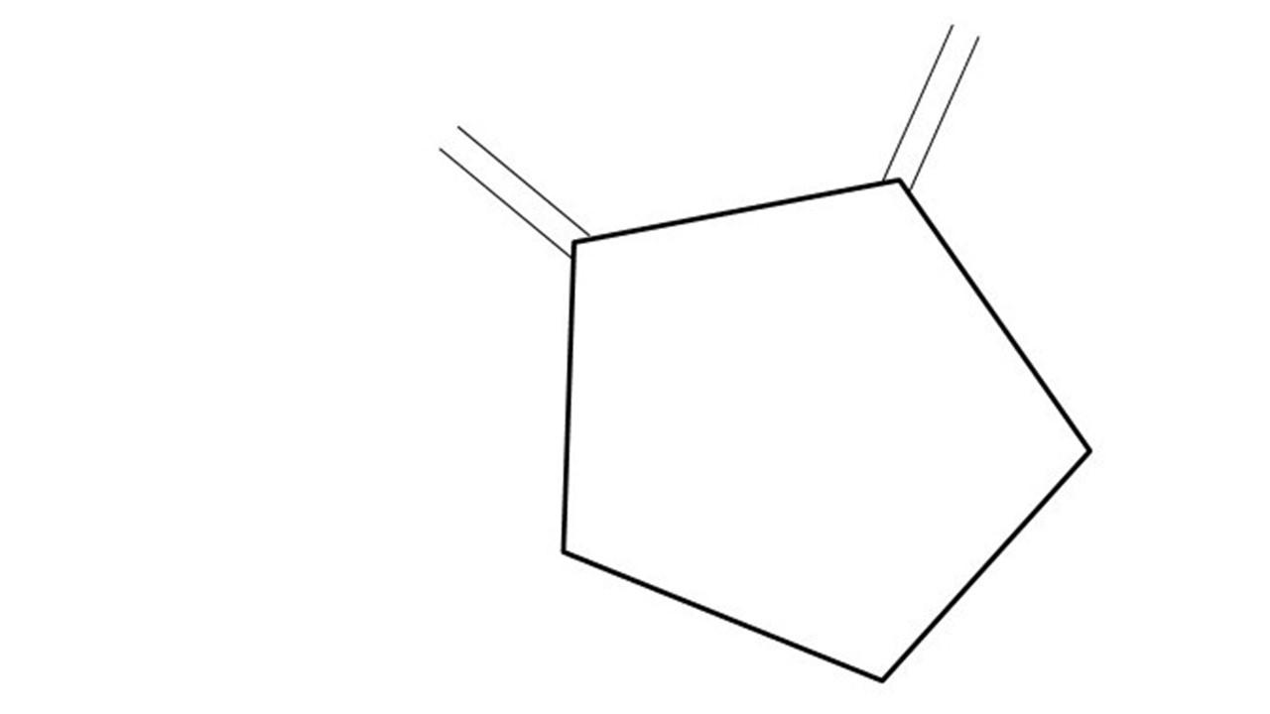
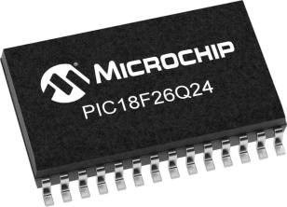
GCBASIC
PIC18FxxQ24
Part 17 - Using CLC

Slide 3
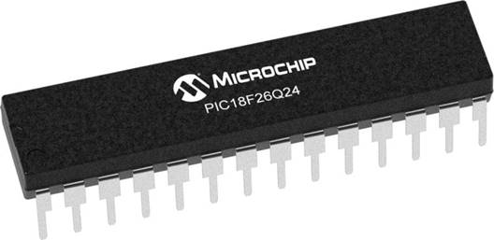
GCBASIC
Like and subscribe!

Slide 4
PIC18FxxQ24
PIC18-Q24 is a high performance PIC18
Digital and Analog peripherals
10-bit ADC
Multiple communication interfaces
Serial, I2C and SPI
PWM – CCP/PWM and 16Bit
Configurable Logic Cells
Multi voltage domains
The PIC18xxQ24 offers 28, 40 and 48-pin products in small footprint packages to support customers in a wide variety of applications.

Slide 5
Videos...
Install the hardware and make the board work – three LED programs
Make four LEDs flash in a sequence
Set the LEDs to represent the value of ADC
Sequence the LEDs with a delay using the value of ADC
Using an input to set the state of the LEDs
Using the reset switch
Using the switch, ADC – make the LEDs flash in a sequence with reverse
Using the serial to display values
Using the timer0 overflow, 8bit timer, 16bit timer to flash the LEDs
Using EEProm – showing values on the serial terminal, and more constants insights
Using I2C with serial to discover I2C devices
Using I2C GCLD display solutions
Using a SPI GLCD display solutions
Using PWM, 6 ways, to dim the LEDS
Using an external interrupt to control an LED
Using storage within the chip
Using CLC
The GCBASIC tool chain
Assembly , alternatives assemblers and MPLAB-X
Summary

Slide 6
GCBASIC Compiler
GCBASIC Compiler
GCBASIC is an Open Source compiler for PIC and AVR microcontrollers
GCBASIC now supports the 18FxxQ24 chip family

Slide 7
Prerequisites
Assumes you have
Installed the GCBASIC software
Installed your programmer software
Test that you have the 18FxxQ24 attached
You have the 4 LEDs operating
You have a POT connected
You have SWITCHes connected
You have a USB/TTL converter

Slide 8
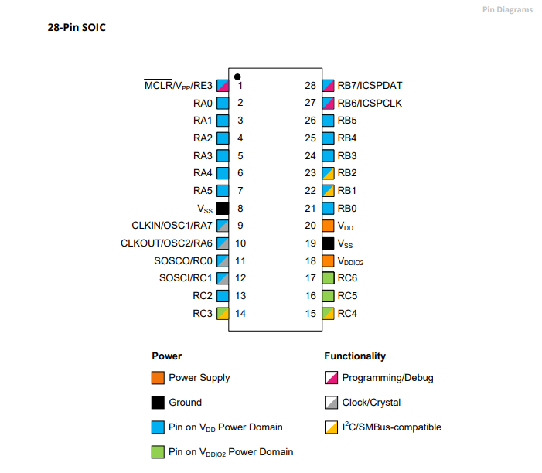
Power Domain – VDDIO2

Slide 9
Hardware
Hardware
-------------------PORTA----------------
Bit#: -7---6---5---4---3---2---1---0---
IO: ----------------SW----------ADC--
----------------------------------------
-------------------PORTB----------------
Bit#: -7---6---5---4---3---2---1---0---
IO: ----------------LED-LED-LED-LED--
----------------------------------------
------------------PORTC-----------------
Bit#: -X---6---5---4---3---2---1---0---
IO: -^--TX---------------------------
-----VDDIO2-----------------------------
You must apply correct Voltage
------------------PORTE-----------------
Bit#: -----------------3---------------
IO: ----------------SW---------------
Prototype Board
Power 5v0
Programmer
LEDs & resistors
Switches & resistors

Slide 10
CLC
CLC Functionality
The CLC module allows users to implement custom logic functions directly in hardware, providing flexibility without CPU intervention
Purpose
It can be used to create complex logic functions with simple configurations

Slide 11
CLC
Key Features
Logic Gates: Configures standard logic gates like AND, OR, XOR, etc
Sequential Logic: Supports latches and flip-flops
Input Sources: Can use internal signals (from other peripherals) and external signals (from pins)
Output Options: Outputs can be routed to other peripherals or I/O pins
Applications
Custom PWM Generation: Used for tasks like motor control
Data Signal Modulation: Can be used to create custom communication protocols
LED Control: Efficiently manage LED lighting sequences.

Slide 12
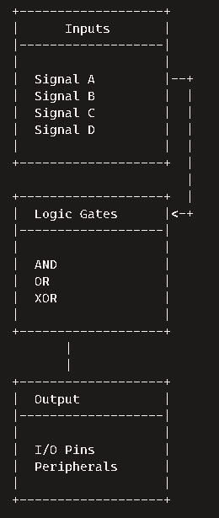
CLC
CLC Diagram
Inputs
Up to 16 input sources can be selected from internal and external signals
Logic Gates Configuration
Configurable logic gates like AND, OR, XOR are used to combine the inputs
Sequential Logic Options
Supports sequential elements like latches and flip-flops
Output
The final logic output can be routed to I/O pins or other peripherals

Slide 13
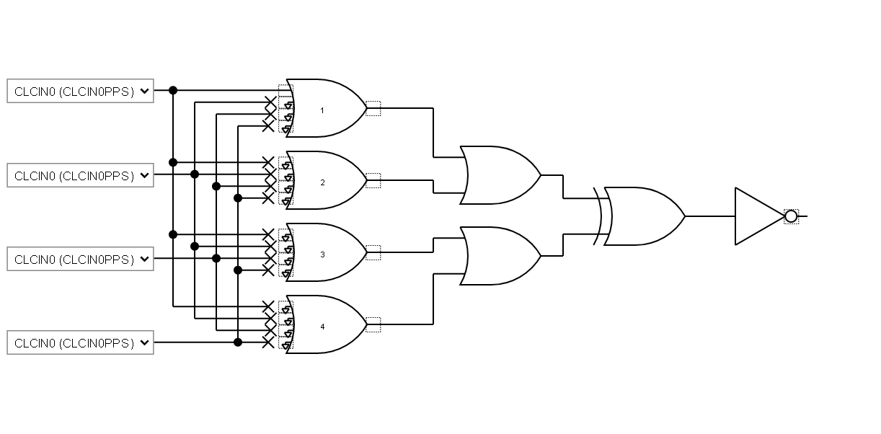
CLC
Digital logic circuit diagram consisting of multiple logic gates. A detailed breakdown:
Inputs:
CLCIN0 (CLCIN0PPS): The primary input signal fed into the circuit.
Logic Gates:
AND Gates: There are several AND gates that process the input signals. These gates output a high signal (1) only if all their inputs are high.
OR Gates: The outputs from the AND gates are fed into OR gates. These gates output a high signal if at least one of their inputs is high.
NOT Gate: The final output from the OR gates is sent through a NOT gate, which inverts the signal. If the input is high, the output will be low, and vice versa.
Outputs:
The result of the NOT gate is the final output of the circuit.

Slide 14
Lab
Create an example using
Microchip Standalone MCC
https://gallery.microchip.com/packages/MCC-Standalone-(Windows)/
https://www.microchip.com/en-us/tools-resources/configure/mplab-code-configurator#download/
C:\Users\{userID}\.mcc
C:\Users\{userID}\.mcc\mcc_generated_files\clc\src\clc1.c - for CLC
C:\Users\{userID}\.mcc\mcc_generated_files\system\src\pins.c - for PPS
GCCode
Basic Hardware
Merge contents
Test and enjoy

Slide 16
Videos...
Install the hardware and make the board work – three LED programs
Make four LEDs flash in a sequence
Set the LEDs to represent the value of ADC
Sequence the LEDs with a delay using the value of ADC
Using an input to set the state of the LEDs
Using the reset switch
Using the switch, ADC – make the LEDs flash in a sequence with reverse
Using the serial to display values
Using the timer0 overflow, 8bit timer, 16bit timer to flash the LEDs
Using EEProm – showing values on the serial terminal, and more constants insights
Using I2C with serial to discover I2C devices
Using I2C GCLD display solutions
Using a SPI GLCD display solutions
Using PWM, 6 ways, to dim the LEDS
Using an external interrupt to control an LED
Using storage within the chip
Using CLC
The GCBASIC tool chain
Assembly , alternatives assemblers and MPLAB-X
Summary

Slide 17
GCBASIC
PIC18FxxQ24
Part 17 - Using CLC

